Slide 1
WHERE MY [ANIMAL] AT
wildlife tracking redefined

Slide 2
TRACKING [WILDLIFE]
Helps us understand how animals move within different areas through time
Used to address climate and land use change, invasive species, and spread of diseases
Tracking methods include GPS, Argos Doppler, Very High Frequency (VHF) Radio Transmitters, Light-Level Geolocators, and Tracking Bands and Rings

Slide 3
[PROBLEMS] AND [SOLUTIONS]
Current methods to view tracking data are unintuitive, such as Movebank and wildlifetracking.org
A more intuitive experience and increased user accessibility is required to improve wildlife tracking data analysis
Using Google Maps API, the user experience is familiar and easy to use
Minimalist design ensures that the interface is not interfering and allows the user to focus on performing data analysis
Assumptions: All animal migration patterns are similar, migration patterns are used to build a predictive algorithm
Current scope is limited to regional migratory species
Current priority set on white-fronted geese migratory patterns in Northern Europe

Slide 4
USING THE [APPLICATION]
Select the species
Select the animal and parameters
Select the timeframe
View tracking data
Example: White Fronted Geese in North-Western Europe

Slide 5
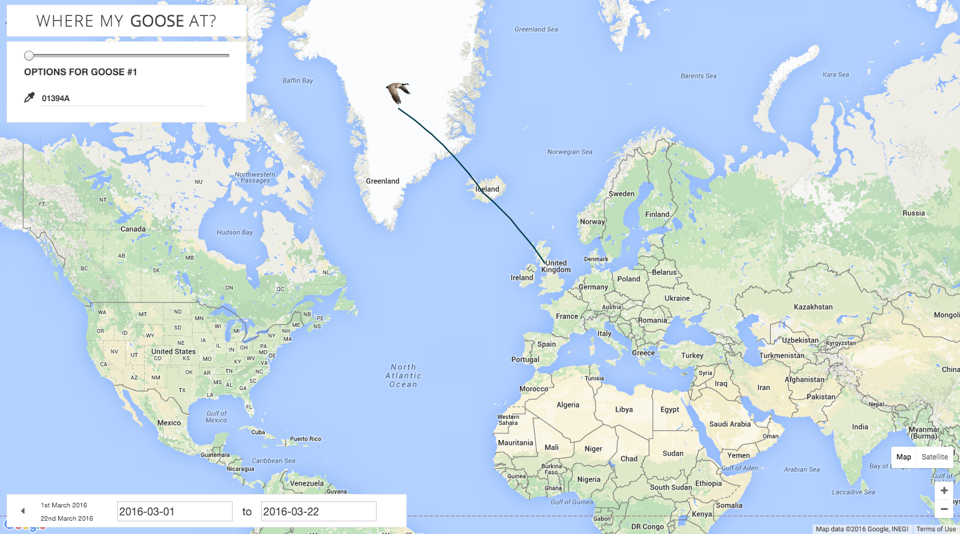

Slide 6
HOW IT [WORKS]
Geographic coordinate and time data from Movebank Data Repository API is loaded into server
Longitude and latitude is converted into position vectors originating from the centre of the Earth
Positions are fitted onto a polynomial curve, future positions are predicted through mathematical algorithms
Positions are retransformed into geographic coordinates
Front-End connects to Back-End Server to retrieve data
User interface displays the location and predicted future positions on map based on Google Maps API

Slide 7
[NEXT STEPS]
Back-end database will be built on Django framework
Increased species support
Allow users to import external tracking data for further analysis
Improved predictive trajectory algorithm using machine learning

Slide 8
[RESOURCES]
What is animal tracking? (n.d.). Retrieved March 13, 2016, from https://www.movebank.org/node/857
Kölzsch A, Müskens GJDM, Kruckenberg H, Glazov P, Weinzierl R, Nolet BA, Wikelski M (2016) Towards a new understanding of migration timing: slower spring than autumn migration in geese reflects different decision rules for stopover use and departure. Oikos. doi:10.1111/oik.03121
Kölzsch A, Kruckenberg H, Glazov P, Müskens GJDM, Wikelski M (2016) Data from: Towards a new understanding of migration timing: slower spring than autumn migration in geese reflects different decision rules for stopover use and departure. Movebank Data Repository. doi:10.5441/001/1.31c2v92f

Slide 9
[QUESTIONS] AND [ANSWERS]
WHERE MY [ANIMAL] AT
christophe gaboury | jordan hu | joshua kwok | paul xu

